Slide 1

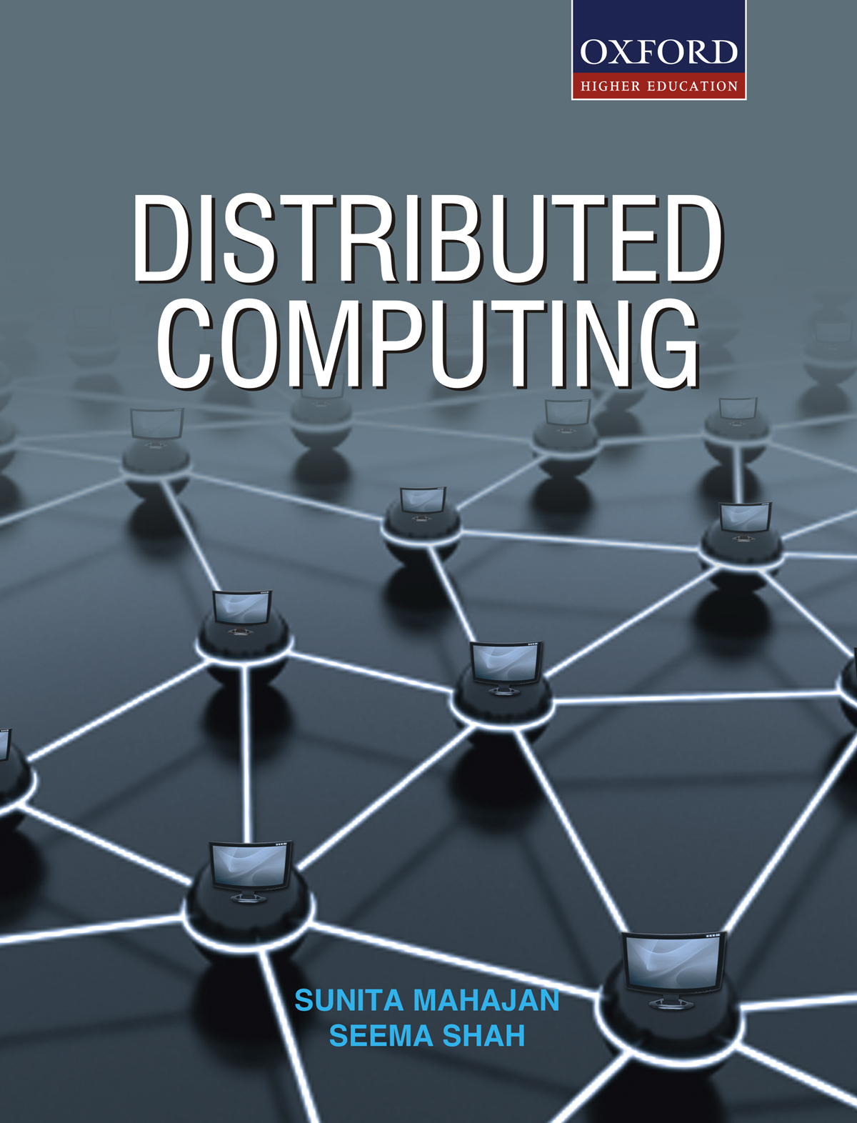
DISTRIBUTED COMPUTING
Sunita Mahajan, Principal, Institute of Computer Science, MET League of Colleges, Mumbai
Seema Shah, Principal, Vidyalankar Institute of Technology, Mumbai University

Slide 2
Chapter - 12
Distributed Database Management System

Slide 3
Topics
Introduction
Distributed DBMS architectures
Data storage in a distributed DBMS
Distributed catalog management
Distributed query processing
Distributed transactions
Distributed concurrency control
Distributed database recovery
Mobile databases
Case study: Distribution and replication in Oracle

Slide 4
Introduction

Slide 5
Distributed Database Concepts
Distributed Database (DDB)
Distributed database Management System (DDBMS)
Distributed Processing
Parallel Database
Advantage of DDBMS
Disadvantages of DDBMS

Slide 6
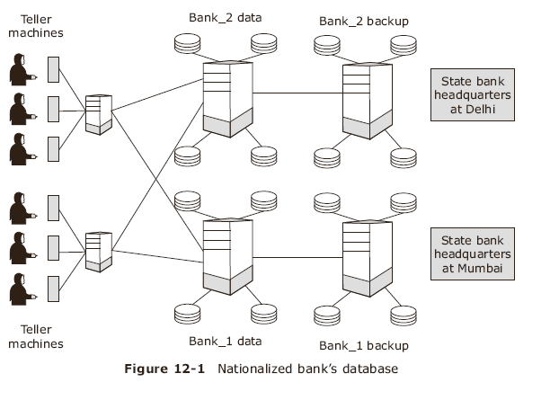
Nationalized Bank’s Database
A logically interrelated collection of shared data physically distributed over a computer network

Slide 7
Distributed Database Management Systems
Database is split in multiple fragments stored at different nodes/sites
Characteristics of DDBMS
  Logically related shared data can be collected
  Fragments can be replicated
  Fragments/replicas allotted to more than one site
  All sites are interconnected
  All local applications handled by on-site DBMS
  Each DBMS takes part in at least one global application

Slide 8
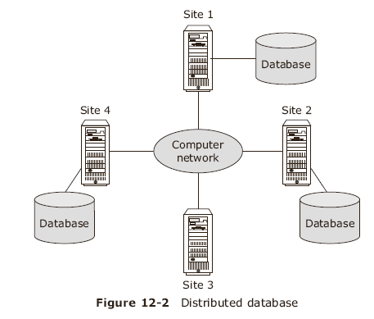
Distributed Database
Different transparencies in DD
Distribution transparency
Replication Transparency
Fragmentation transparency
Data resides in databases at individual nodes

Slide 9
Distributed Processing
Difference between Distributed processing and distributed DBMS
  Distributed processing consists of a set of processing units networked together enabling access to a centralized data
  A distributed database fragments centralized data on multiple nodes and accesses them as a homogenized entity

Slide 10
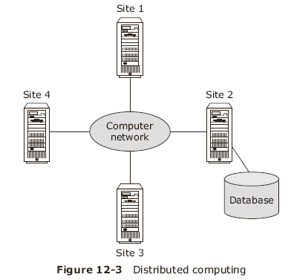
Distributed processing
Data resides in a centralized database

Slide 11
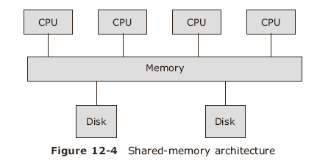
Parallel DBMS -1
Shared memory architecture

Slide 12
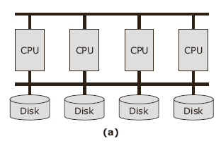
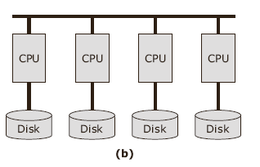
Parallel DBMS -2
Shared Disk
Shared Nothing

Slide 13
Advantages of DDBMS
Reflection of organizational structure
Improved shareability and local autonomy
Improved availability and reliability
Improved performance
Improved Economics
Modular growth

Slide 14
Disadvantages of DDBMS
Complexity
Cost
Security
More difficult integrity control
Lack of proper standards
Lack of experience
More complex design

Slide 15
Functions of DDBMS
Communication services to provide remote data access
Keeping track of data
System catalog management
Distributed query processing
Replicated data management
Distributed database recovery
Security
Distributed directory management

Slide 16
Types of Distributed Databases
Homogeneous DDBMS
Heterogeneous database
Multi-database systems

Slide 17
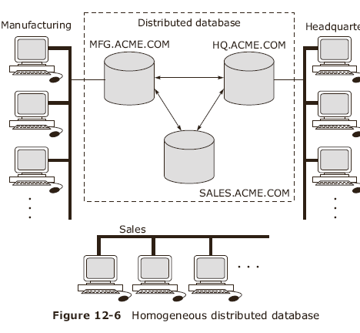
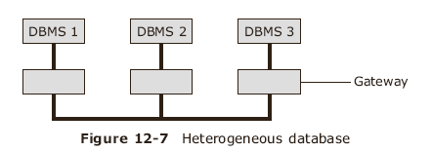
Homogeneous and heterogeneous
DDBMS

Slide 18
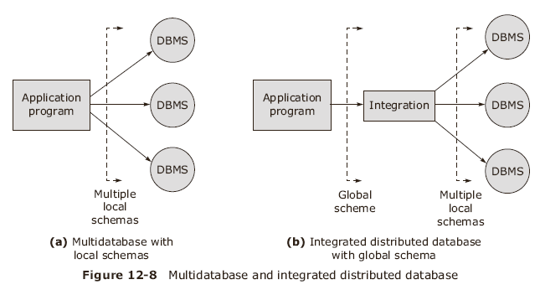
Multi database systems

Slide 19
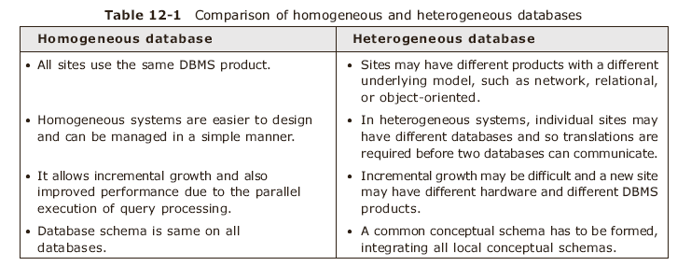
MDBMS can be classified as Unfederated and Federated

Slide 20
Distributed DBMS Architectures

Slide 21
Distributed DBMS Architectures
Client-server architecture
Collaborating server architecture
Middle ware architecture

Slide 22
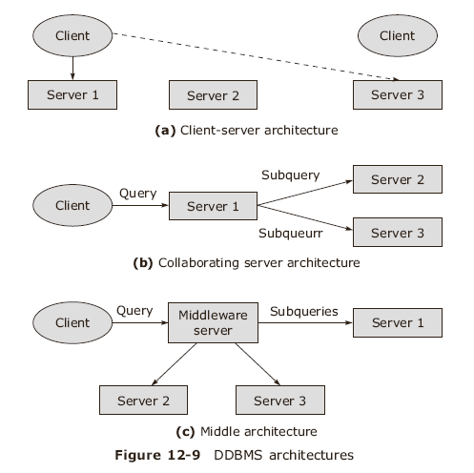
subquery

Slide 23
Data Storage in DDBMS

Slide 24
Data Storage in DDBMS
A single relation either fragmented across several sites
Objectives for definition and allocation of fragments
  Locality of reference
  Improved reliability and availability
  Acceptable performance
  Balanced storage capacities and costs
  Minimal communication costs

Slide 25
Data Allocation
Motivation for data allocation
  Increased availability of data
  Faster query evaluation
Strategies for data allocation
  Centralized
  Partitioned / Fragmented
  Complete replication
  Selective replication

Slide 26
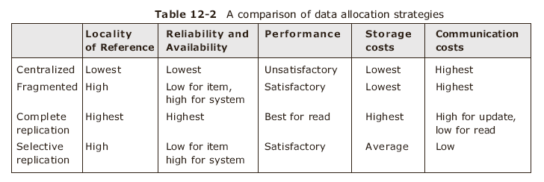
A Comparison of Data Allocation strategies

Slide 27
Fragmentations
Why fragmentation
  Usage
  Efficiency
  Parallelism
  Security
Disadvantages of fragmentation
  Performance
  integrity

Slide 28
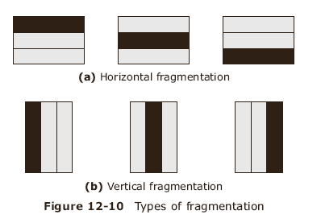
Fragmentation
Horizontal - Vertical
Correctness rules – Completeness, Reconstruction, Disjointness

Slide 29
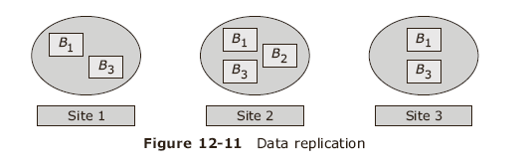
Replication
Some relations are replicated and stored in multiple sites. Replication helps in increased availability of data and faster query evaluation

Slide 30
Distributed Catalog Management
Centralized global catalog
Replicated global catalog
Dispersed catalog
Local-master catalog
Naming objects
Catalog structure
Distributed data independence

Slide 31
Naming objects
Every data item must have a system-wide unique name
Data item should be located efficiently
Location of data item should be changed transparently
Each site should create data item autonomously
Solution: use names with multiple fields – local name field and birth site field

Slide 32
Catalog Structure
R* Distributed Database Project
Each site maintains a local catalog for all copies of data stored at the site
Catalog at birth site keeps track of locations of replicas and fragments
This catalog contains a precise description of
  Each replica’s contents
  List of columns for vertical fragments
  Selection condition for horizontal fragments

Slide 33
Distributed Data Independence
Queries should be written irrespective of how the relation is fragmented or replicated
Users need not specify full name for the data objects accessed while evaluating query
User may create a synonym for the global relation name to refer to relations created by other users
DBMS maintains a table of synonyms as a part of system catalog

Slide 34
Distributed Query Processing

Slide 35
Distributed query processing
Non-join queries in a DDBMS
Joins in a DDBMS
  Semijoins
  Bloomjoins
Cost-based query optimization challenges
  Minimizing communication costs
  Preserving the autonomy of individual sites

Slide 36
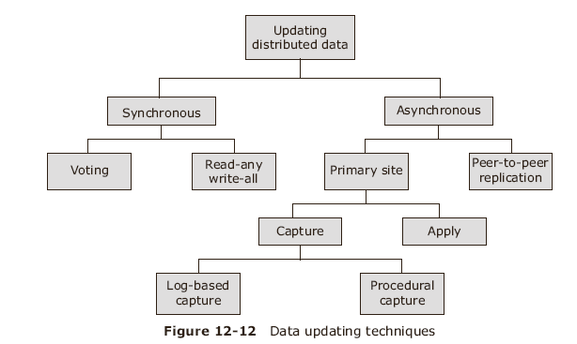
Updating Distributed Data

Slide 37
Distributed transactions
Atomicity of global transactions should be ensured
ACID properties should be present :
  *Atomicity *Consistency *Isolation *Durability
Data modules present are: transaction manager, scheduler, buffer manager , recovery manager and transaction coordinator

Slide 38
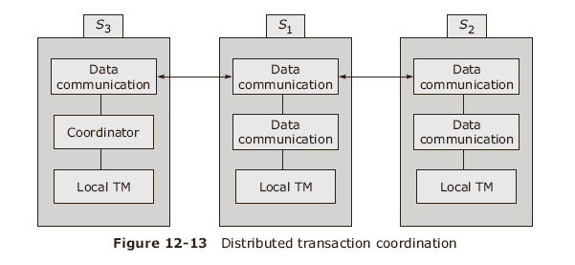
Distributed transactions

Slide 39
Distributed Concurrency Control

Slide 40
Distributed Concurrency Control
Some definitions
  Schedule : a sequence of operations by a set of concurrent transactions
  Serial schedule: operations of each transactions executed without any interleaving from other transactions
  Non-serial schedule: operations from a set of transactions are interleaved
  Locking : procedure to control concurrent access to database
  Shared lock: allows only reading data item
  Exclusive lock: allows reading and updating data item

Slide 41
Objectives of concurrency control
All concurrency mechanisms must preserve data consistency and complete each atomic action in finite time
Important capabilities are
  Be resilient to site and communication link failures
  Allow parallelism to enhance performance requirements
  Incur optimal cost and optimize communication delays
  Place constraints on atomic actions

Slide 42
Distributed serializability
A serializable local schedule leads to global schedule being serializable provided local schedules are identical
Two major approaches for concurrency control are :
  Locking
  Timestamping
Locking guarantees that concurrent execution is nearly equal to some serial execution of those transactions
Timestamping guarantees that concurrent execution is equal to specific serial execution specified by these timestamps

Slide 43
Locking protocols
Centralized 2PL ( two phase locking )
Primary copy 2PL
Distributed 2PL
Majority locking
Biased protocol
Quorum consensus protocol

Slide 44
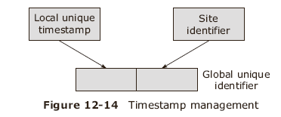
Timestamp protocol
Objective is to order a transaction globally such that older transactions ( smaller timestamps) get priority in the event of conflict.

Slide 45
Distributed deadlock management
Deadlocks must be avoided
  They must be prevented
  Or detected
Centralized Deadlock detection
Hierarchical deadlock detection
Distributed deadlock detection

Slide 46

Deadlock example
Consider 3 transactions T_{1 ,}T₂, T₃ at different sites S₁, S₂, S₃. x, y, z are 3 objects replicated at all 3 sites and x₁ for copy at S₁, y₂ for copy at S₂ and z₃ for copy at S₃

Slide 47
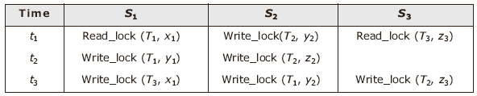
Deadlock Example cont.
At time t₁, T₁ sets a shared lock on x, T₂ puts an exclusive lock on y and T₃ puts a shared lock on z.
At t₂, T₁ wants exclusive lock on y but T₂ has already put an exclusive lock on y so T₁ has to wait.
At t₃, T₂ wants an exclusive lock on z but T₃ has put a shared lock on z so T₂ has to wait.
At t₃, T₃ wants an exclusive lock on x, but T₁ has put a shared lock on x.

Slide 48
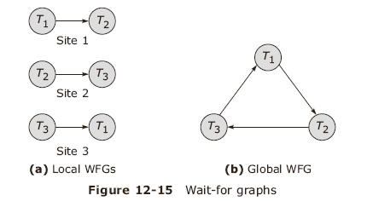
Wait For Graphs (WFG)
Phantom deadlocks are deadlocks which are caused by delays in propagation

Slide 49
Centralized deadlock detection
A single site defined as deadlock detection coordinator (DDC)
DDC responsible for constructing and maintaining the global WFG
Each lock manager sends its WFG to DDC
DDC builds global WFG and checks for cycles
If cycles are detected, DDC breaks the cycle by rolling back a particular transaction

Slide 50
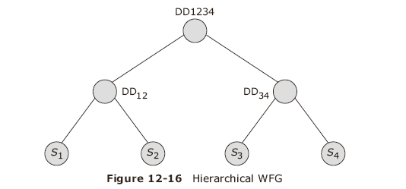
Hierarchical deadlock detection
S1, S2, S3 and S4 are the sites where transactions take place
DD12 is deadlock involving sites 1&2 and so on.

Slide 51
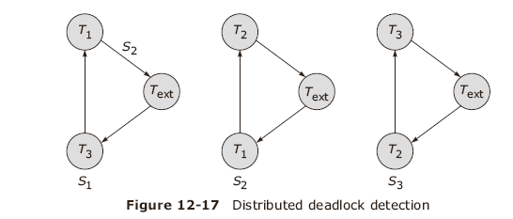
Distributed Deadlock detection
T _{ext} is an external node to local WFG to hint that an agent is introduced at a remote site

Slide 52
Distributed database recovery

Slide 53
Distributed database recovery
Failures in Distributed environment
  Loss of message
  Failures of communication link
  Failure at a site
  Network partitioning
  Failures affecting recovery
Distributed recovery protocol
  Two-phase commit (2PC)
  Three-phase commit (3PC)

Slide 54
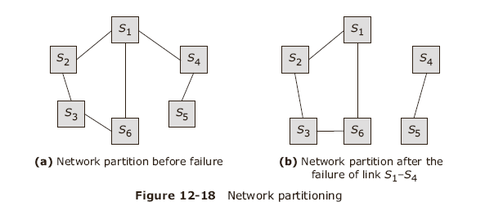
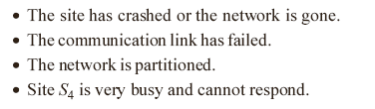
Network partitioning
If the network of nodes has failed, any one of the reasons may exist

Slide 55
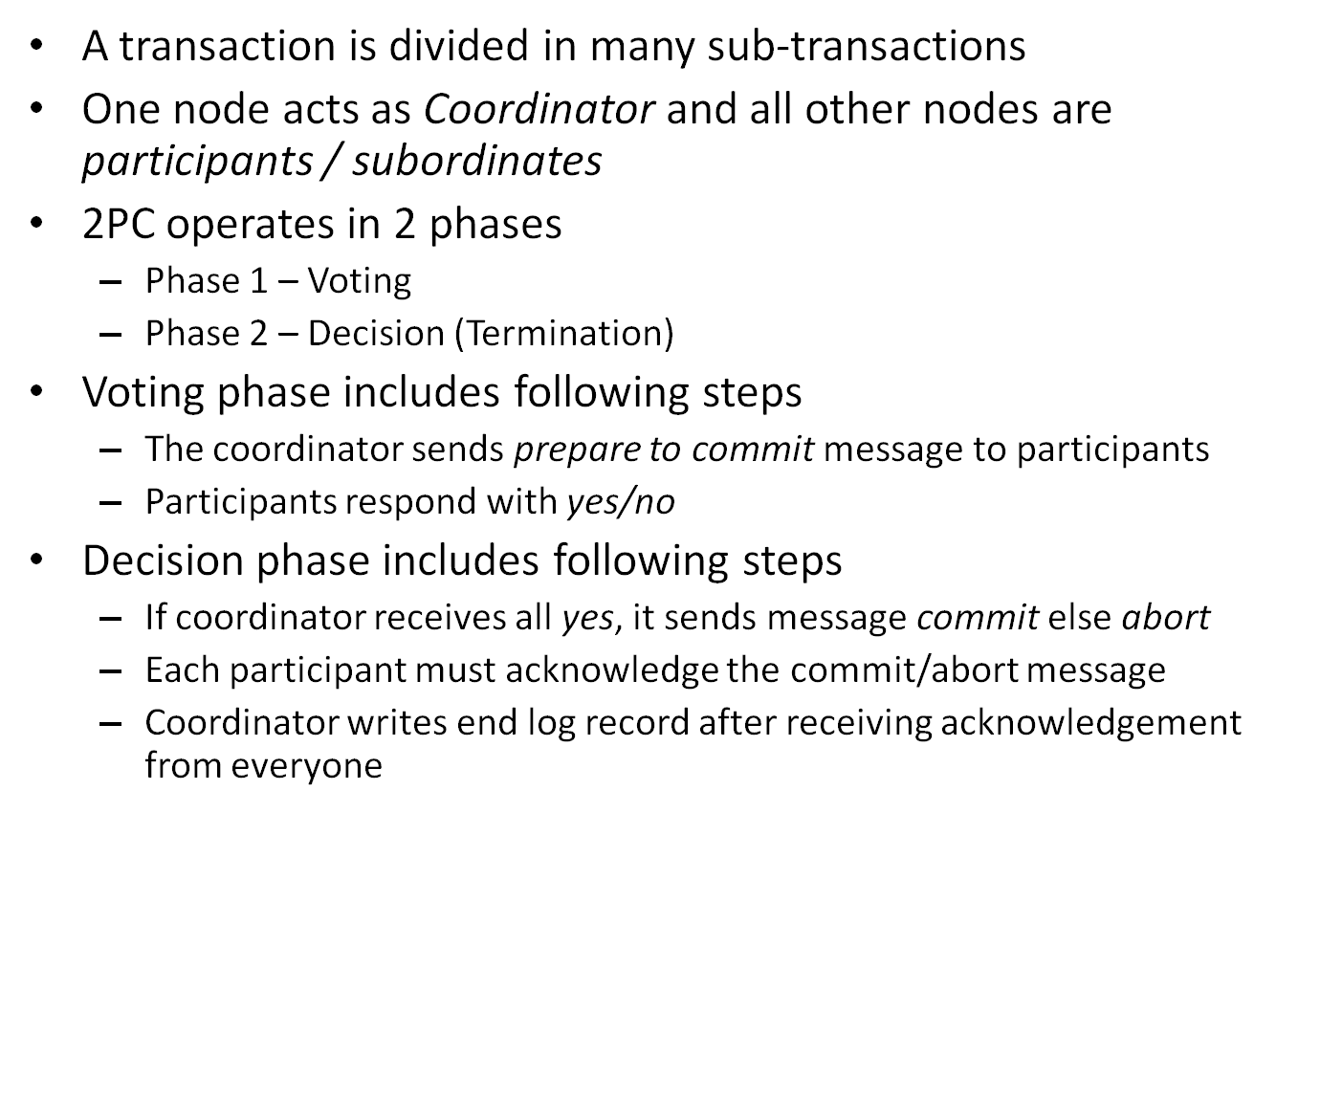
Two-phase commit

Slide 56
2PC discussed
Two Phase commit exchanges 2 phases of messages – Voting and Termination
When a message is sent, its log record is forced to stable storage
A transaction is committed when the Coordinator’s commit log reaches the stable storage
Fail-stop model of 2PC means failed sites stop working

Slide 57
Site crashed-Recovery procedure
When a site comes up, recovery procedure checks the log
  If commit record exits then redo else undo the transaction
  If prepare log record but no commit / abort then contact coordinator repeatedly to find the status of transaction
  If no prepare, commit or abort then abort and undo the transaction

Slide 58
Recovery procedure cont
Coordinator fails and no message is given to participants, then transaction T is blocked till Coordinator recovers
Remote site does not respond during commit protocol, then either communication link or site have failed- Then actions taken:
  If coordinator fails, abort T
  If participant and not voted yes then abort T
  If participant and voted yes then blocked till coordinator responds

Slide 59
2PC with Presumed Abort
Basic observations regarding 2PC protocols
  Ack messages are useful in knowing whether all participants are aware of decision.
  The coordinator site fails after sending prepare but before writing commit/abort then it has no information about T after coming up. Then it is free to abort
  If subtransaction does no updates, then no changes, it is a reader

Slide 60
2PC with Presumed Abort cont
When coordinator aborts a transaction it can undo T so default is to abort
No acknowledgement needed after abort message
All short log records can be appended to the log tail
If a sub-transaction does no updates, it responds by saying it s a reader so no log record
If coordinator receives a reader it treats it as yes
If all subtransactions are readers, second phase is not required

Slide 61
Three phase commit
A third phase introduced to avoid blocking
Three phases are :
  Phase 1: Voting – Coordinator sends a prepare message and receives yes vote from all
  Phase 2: Precommit – Coordinator sends a precommit/abort message to all participants, most respond with ack
  Phase 3 : Termination – when sufficient number of messages have been received, Coordinator force-writes a commit log record and then sends a commit message to all

Slide 62
Advantages of 3 PC
The Coordinator postpones decision till sufficient number of sites know about
If Coordinator fails, participants can communicate with each other and decide to commit/abort
Due to precommit phase, transaction is not blocked

Slide 63
Mobile Databases

Slide 64
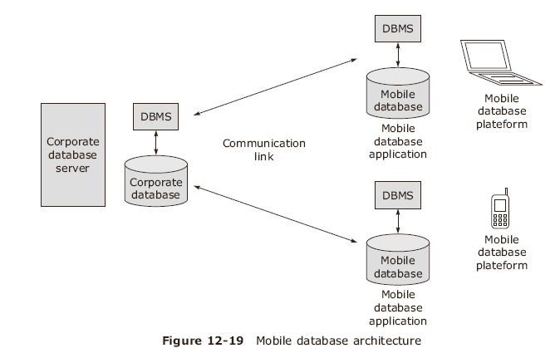

Mobile Databases

Slide 65
Mobile Database Environment
A Corporate database server and DBMS
  Managing corporate data and providing applications
A remote database and DBMS
  Storing mobile data and providing applications
A mobile database platform i.e. laptop or PDA
Two-way communication link between mobile and corporate database

Slide 66
Case study – Distribution and Replication in Oracle

Slide 67
Oracle’s Distributed Functionality
Connectivity
Global database names
Database links
Referential integrity
Heterogeneous distributed database
Distributed query optimization

Slide 68
Oracle’s Replication Functionality
Oracle supports synchronous and asynchronous replication through Oracle advanced replication
There is a Master site and multiple slave sites and Master can replicate changes to slave sites
Oracle supports 4 types of replication
  Read-only snapshots
  Updatable snapshots
  Multimaster replication
  Procedural replication

Slide 69
Summary
Distributed DBMS architectures
Data storage in a distributed DBMS
Distributed catalog management
Distributed query processing
Distributed transactions
Distributed concurrency control
Distributed database recovery
Mobile databases

